Slide 1
Mitigating Hallucination in LLMs
Paper Review and Project Direction
RA Application - CANSSI Project
Wilfrid Laurier University

Slide 2
WHY HALLUCINATION MATTERS
Fluent but Factually Wrong
Poor Calibration
Distribution Mismatch
Two Papers Reviewed

Slide 3



PAPER 1: OBJECTIVES
Wheel of Emotions (Wang et al., 2026)
Multimodal LLMs
Hallucination = Emotional Misalignment
Plutchik’s Wheel guides generation

Slide 4
PAPER 1 METHODS (EAI Framework)
How EAI Works: Three Stages
Extract emotion from text + images
Map emotions onto the Wheel, boost/supress
Penalize hallucinated emotions in final output
MULTIMODAL INPUT
EMOTION CONTRAST
HALLUCINATION PENALTY
[Input] Text + Image
[Emotion Mapping] Wheel of Emotions + EBF Weights
[Output] Clean Genereation
1
2
3
L'(y) = L(y) + α·E_pos(y) − β·E_neg(y)

Slide 5
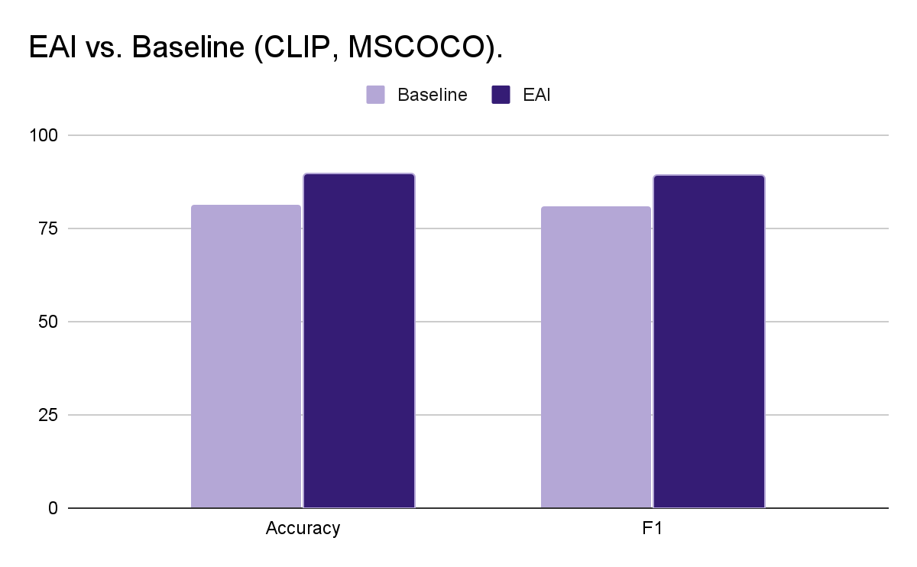


Paper 1: Results and What’s Next
Results
Future Works:
Audio Modality
Multi-turn Dialogues
Lightweight Deployment
+4-8% acc/F1
Negative context reveals hallucinations

Slide 6
PAPER 2: OBJECTIVES
AG, Reasoning & Agentic Systems (Li et al., 2025)
Survey of Three mitigation Paradigms
Taxonomy: knowledge-based vs logic-based
Capability enhancement, not error suppression
RAG
Reasoning
Knowledge-based Hallucination
Logic-based Hallucination
Wrong Facts
Flawed Reasoning
“Mary Johnson was the first US astronaut”
“Today is colder, so tomorrow will be
definitely cold too”

Slide 7
Paper 2: Methods Reviewed
Three Paradigms for Mitigation
RAG
Reasoning
Agentic Systems
Pre-retrieval
Retrieval
Post-retrieval
Fixes: Knowledge Hallucinations
Chain-of-Thought
Tool-augmented
Symbolic
Fixes: Logic Hallucinations
Combines RAG + Reasoning
Planning, reflection, memory
Fixes: Composite Hallucinations

Slide 8
Paper 2: Benchmarks & Future Work
Benchmarks & What's Next
Future Works:
Standardized RAG + Reasoning Integration
Balance reliability vs. creativity
Lightweight agentic systems
Hallucination Type | Example Benchmark | Capability Tested
Knowledge-based | TruthfulQA | Factual accuracy
Logic-based | LogicBench | Reasoning validity
Composite | AgentBench | Agentic workflows

Slide 9
Synthesis & Project Direction
Connecting the Papers to This Project
BEFORE
DURING
AFTER
Data Normalization
My focus
Paper 1: Emotion
Paper 2: RAG/CoT
Post-hoc Verification

Slide 10
References
Wang, Z., Wang, J., & You, F. (2026). Large language modeling of hallucinatory problem mitigation based on the wheel of emotions. Eural Netwroks, 193, 107996.
Li, Y., Fu, X., Verma, G., Buitelaar, P., & Liu, M. (2025). Mitigating Hallucination in Larbe Language Models (LLMs): An application-Oriented Survey on RAG, Reasoning, and Agentic Systems arXiv:2510.24476.
Lin, S., Hilton, J., & Evans, O. (2022). TruthfulQA: Measuring How Models Mimic Human Falsehoods. Proceedings of ACL 2022, 3214-3252.

